Slide 1
GoSoapbox
Ryan Gimbel

Slide 2
Link: https://app.gosoapbox.com/
Accesscode:250-433-214
Creating: I would use this in my first student teach to gauge my students prior knowledge on the subject matter. This allows me to rate their comfort with the subject matter. It would also allow me to judge the motivation and confidence of my students.

Slide 3
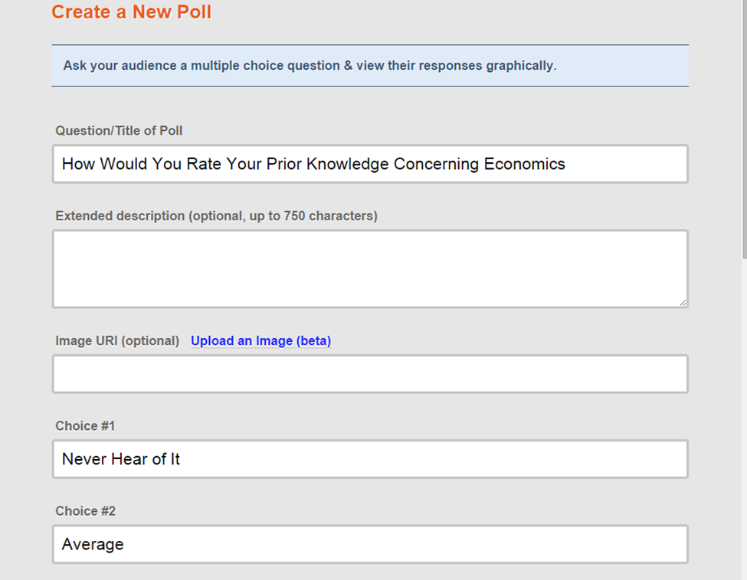

Slide 4
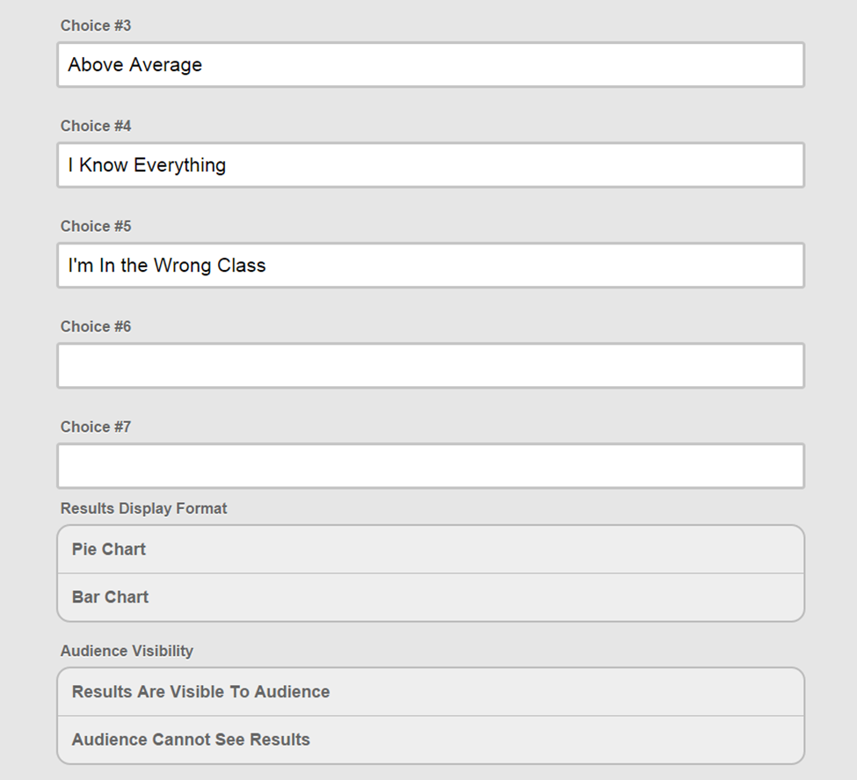

Slide 5
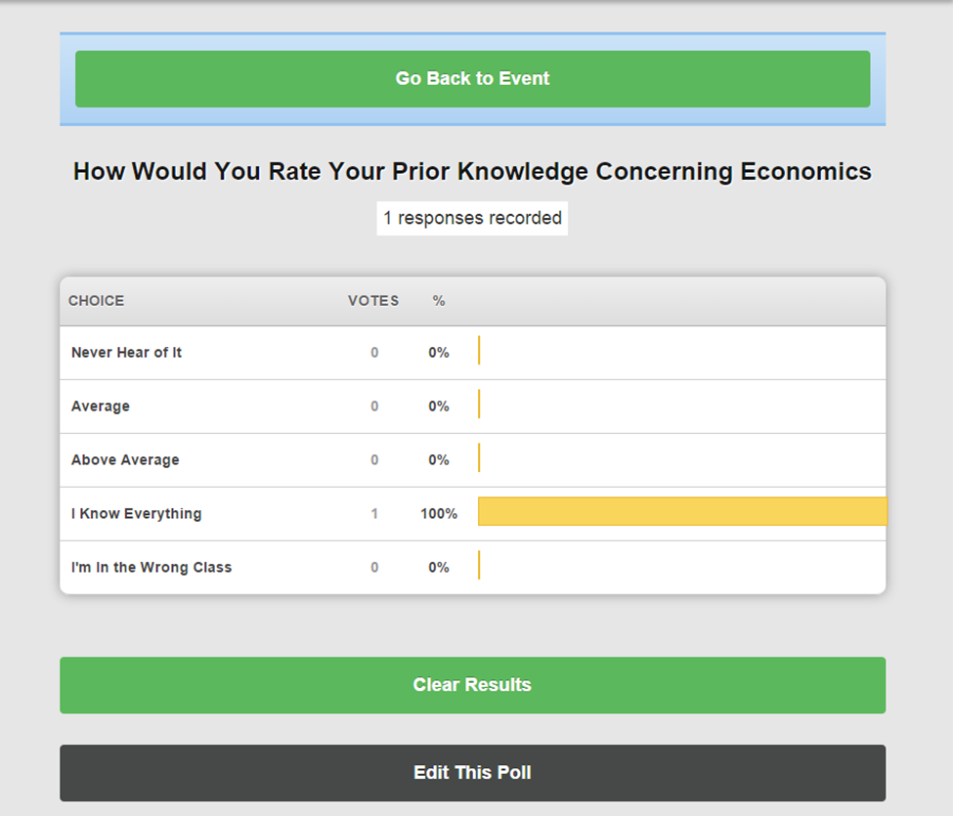

Slide 6
