Slide 1
Rocket
Ryan Gimbel

Slide 2
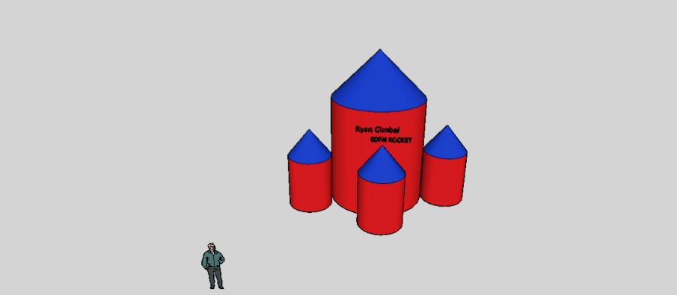

Slide 4
