Slide 1
How to insert AND create A WIZ WEBSITE
Ryan Gimbel

Slide 2
First Step is selecting a template

Slide 3
Select you type of template

Slide 4
Wix started video
Link: https://www.youtube.com/watch?v=AaJqrm4s0GI

Slide 5
Adding pdf/zip file
In your document click on add, click the box media, in the media tab click document, and a screen will appear in the top right corner will be a yellow box and there you will chose the file you would like to add.
Picture next slides
Follow the arrows

Slide 6
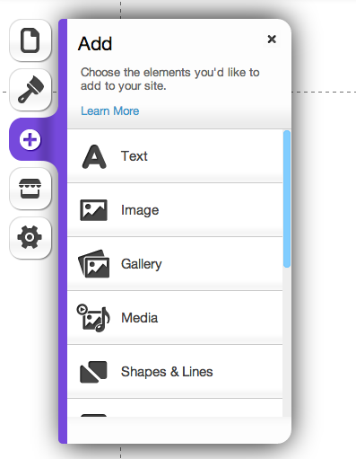
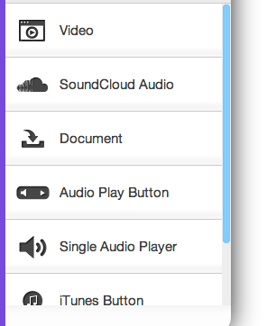
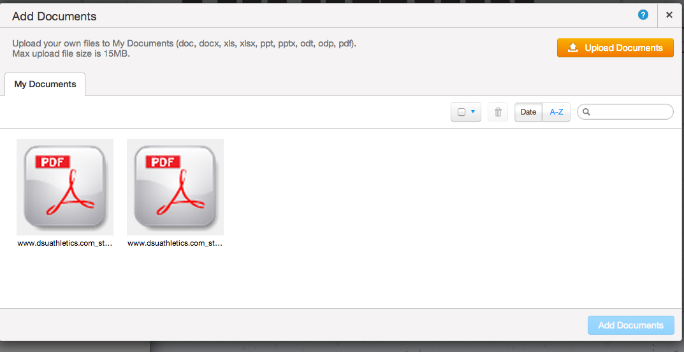
For Uploading pdf’s and zip files

Slide 7
Adding Google maps
In your document click on add, scroll down the add box and click the box apps, then in the app box click Google maps. From there a map and setting will appear, type the address you wish to see, and then type its description. Done
Pictures to follow
Follow the arrows

Slide 8
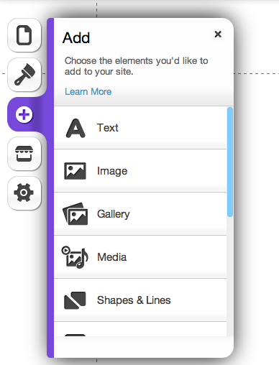
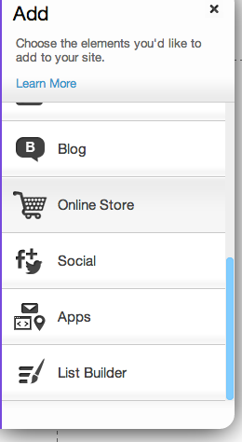
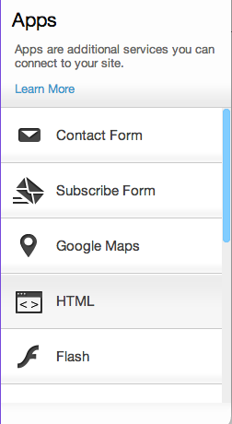
Adding Google maps

Slide 9
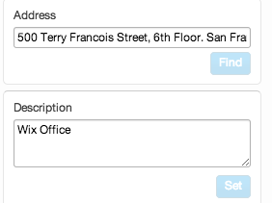
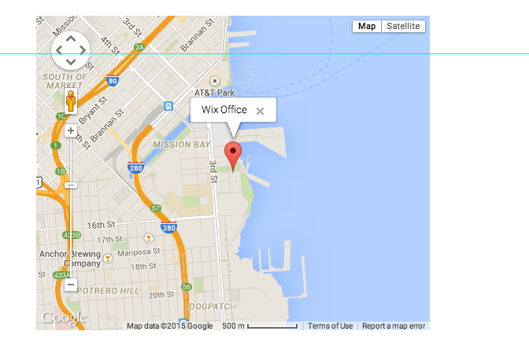
adding Google MAPS CONT.
Type in address of your choice

Slide 10
Adding video
In your document click on add, in the add box click media, then click video at the top tile called video, the wix video will appear, click on the video and a video box is going to appear, click setting. A drop down box will appear enter the url to the video you would like on the cite and you are done.
Pictures to follow
Follow the arrows

Slide 11
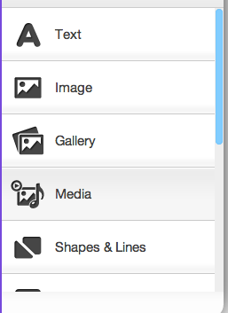
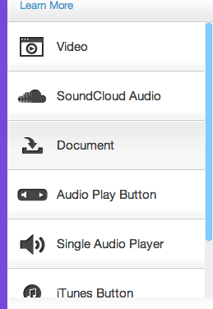
Add a video

Slide 12
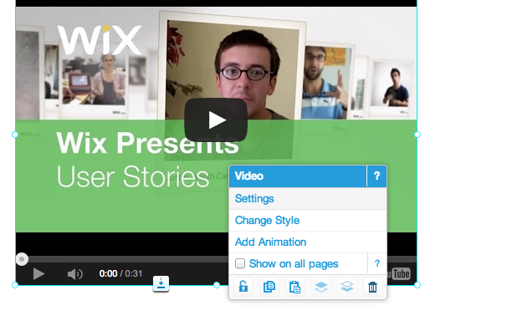
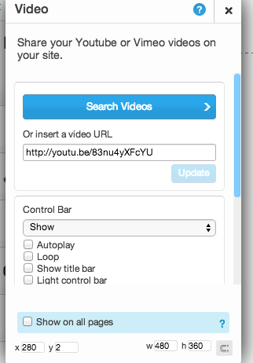
Add a video cont.

